Slide 1
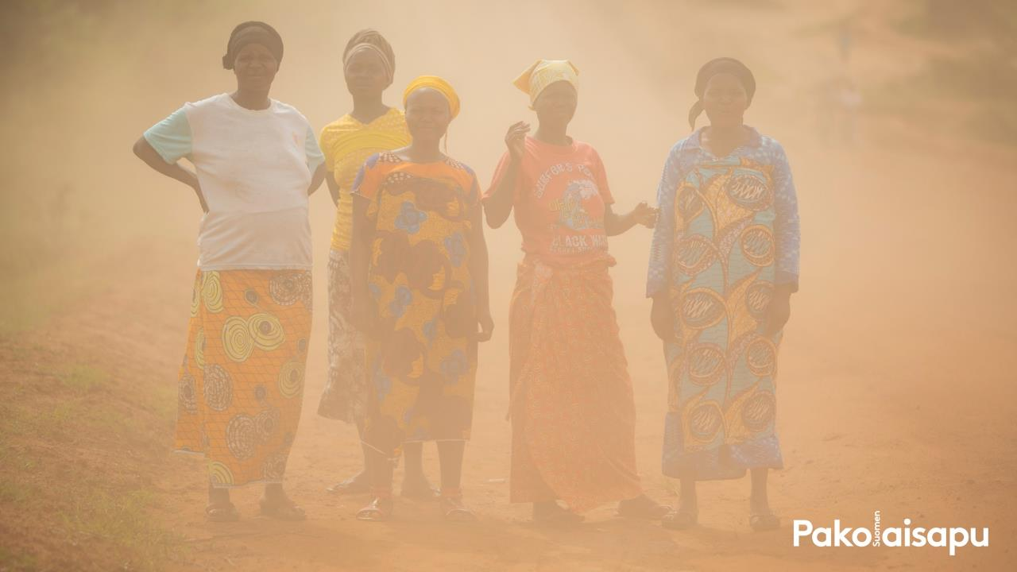
CLIMATE CHANGE
AND REFUGEES:
GLOBAL CHALLENGES
FOR HUMANITY
Learning material for educators

Slide 2

The Finnish Refugee Council is Finland’s largest expert organisation specialising in the issues of displacement and migration. Each year, we support thousands of people in recovering from conflicts and integrating into new societies. For over 50 years our work has positively impacted lives in Finland, Africa, the Middle East, Asia and Europe.
We currently support refugees and migrants in Finland, Uganda, Myanmar and Turkey. We are also starting operations in Ethiopia in the near future.

Slide 3
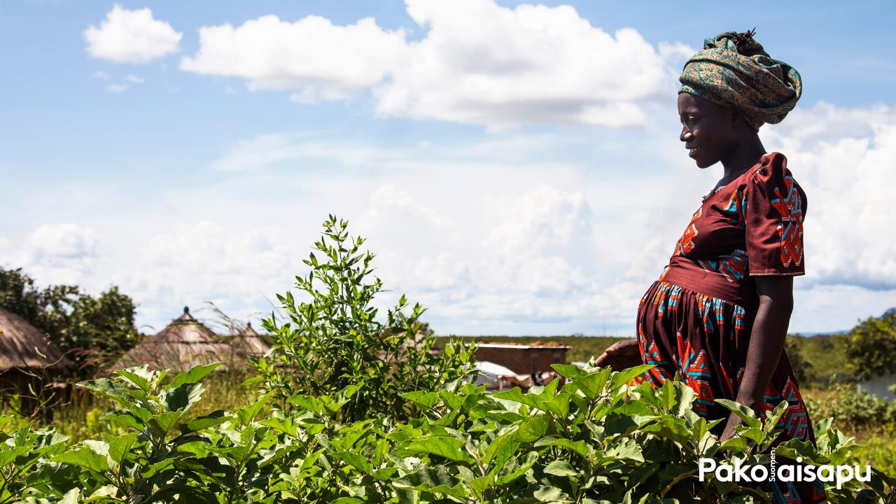
MISsIOn
We support the realisation of refugees’ and migrants’ rights and their equal inclusion as members and builders of societies.
VISIOn
Refugees and migrants are equal and participating members of their societies, and their basic rights are realised in a positive atmosphere of attitudes.
values
• Fairness
• Inclusion and equality
• Transparency and responsibility

Slide 4
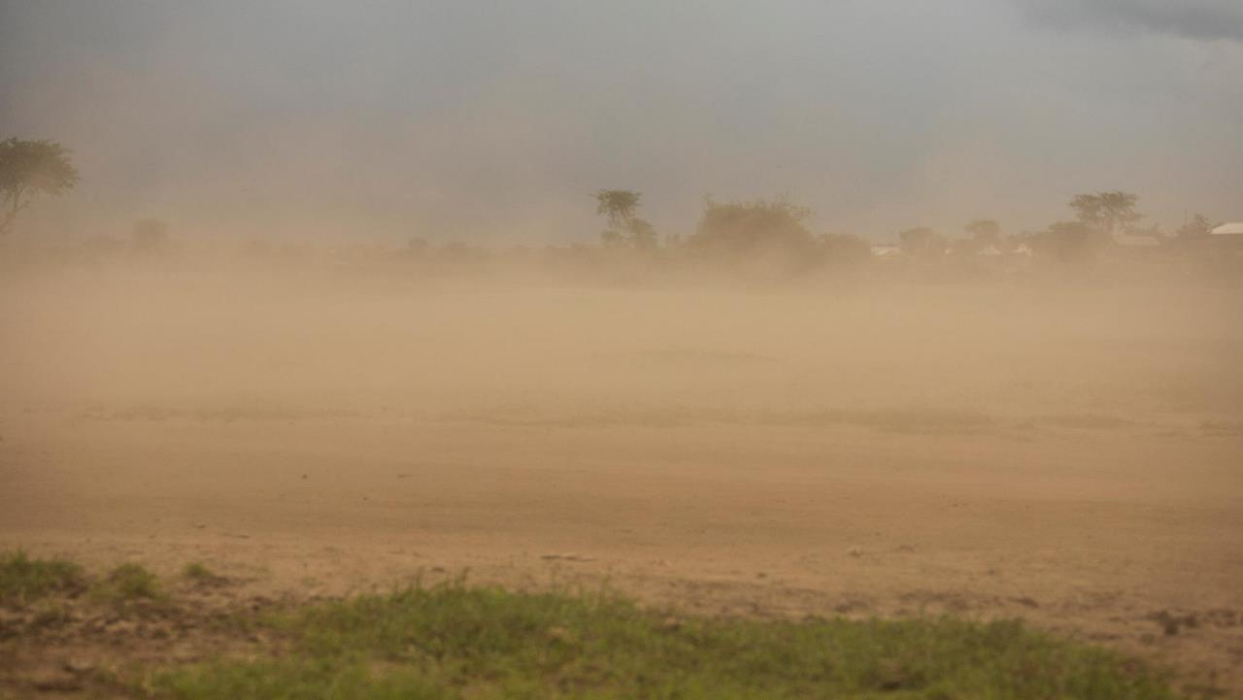
CLIMATE CHANGE RADICALLY CHANGES LIVING CONDITIONS

Slide 5
WHAT CAUSES CLIMATE CHANGE?
• As the amount of greenhouse gases in the atmosphere increases, the climate changes.
- The increase is due to human activity.
• Compared to the pre-industrial period (1850– 1900), the average temperature of the planet has already increased by roughly one degree Celsius.
• The most important greenhouse gas is carbon dioxide.
- The others are methane, nitrous oxide and hydrofluorocarbons.
• Greenhouse gases keep the planet habitable, but as the amount of emissions increases, the temperature rises.
- This changes the climate of the planet to an unfavourable direction.

Slide 6
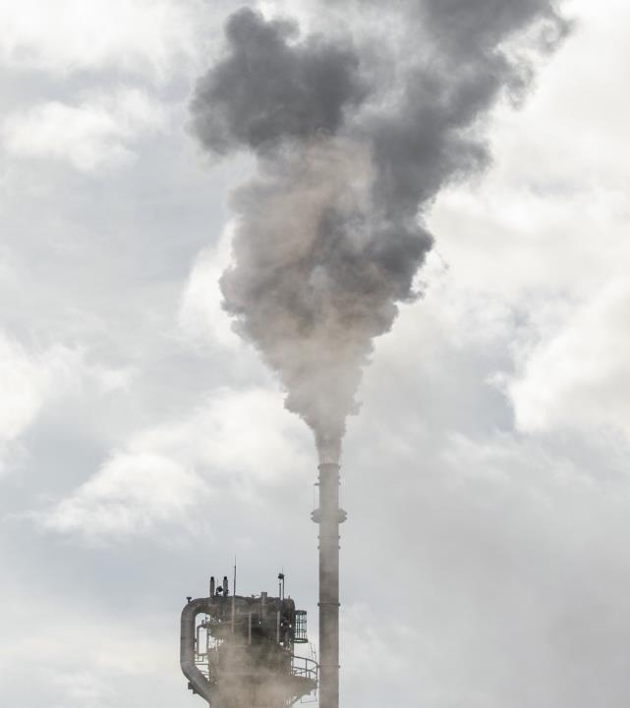
THE AMOUNT OF GREENHOUSE EMISSIONS IS SIGNIFICANT
• In order to control the average temperature of the
planet, the amount of greenhouse gas emissions must
reach zero by the midpoint of the century.
• The largest source of greenhouse gas emissions is the
energy sector (72% of the emissions).
• China produces the largest amount of carbon dioxide
emissions.
- The next largest amounts of emissions come from
the United States, India, Russia and Japan.
- If the emissions from the EU are counted as a
whole, they are the third largest globally.
• In 2015, states committed to the Paris Agreement.

Slide 7

CLIMATE CHANGE AFFECTS SOCIETIES
• The impact of climate change’s effects is largely dependent on how much the average temperature of the planet rises.
• The predicted impact is much more severe if the average temperature increases by 2 degrees instead of 1.5.
• Climate change affects issues such as health, sources of livelihood, availability of water, economic growth and human safety.

Slide 8
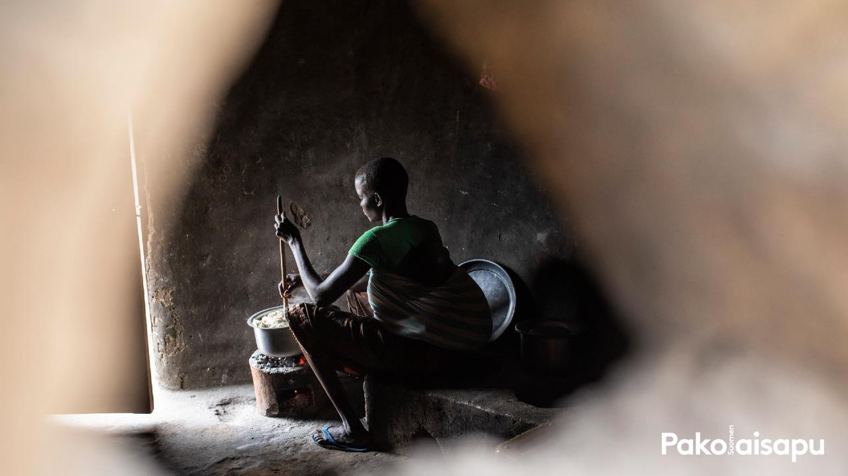

WHY DO PEOPLE FLEE?

Slide 9
ASSIGNMENT: WHY-WHY-WHY
Place the flip chart paper in a horizontal position and draw 3 vertical lines across it so that there are 4 columns on the paper.
Write ‘Why do people leave their homes?’ in the first column.
Listen carefully what should be written in each column.
You have 3 minutes to complete each column.
Why do people
leave their
homes?

Slide 10
HOW MANY DISPLACED PEOPLE WERE THERE IN 2023?
A) 79.5 million
B) 25.3 million
C) 53.3 million
D) 117.3 million

Slide 11
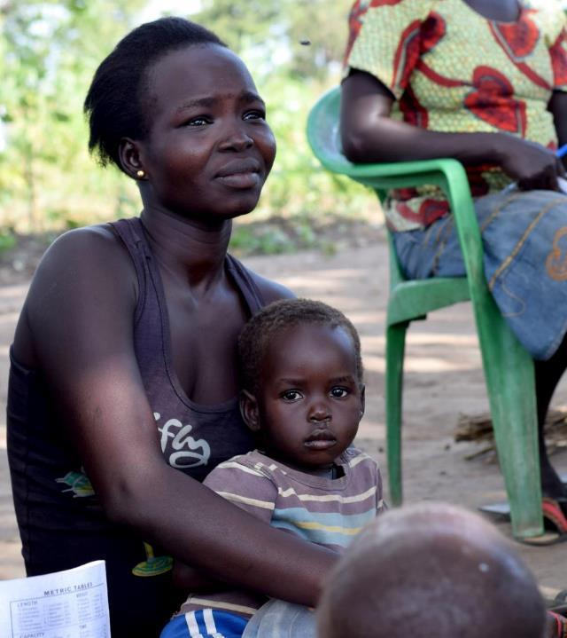
THE DISPLACED PEOPLE OF THE WORLD
117.3 million forcibly displaced
people
31.6 million
67 million
6,9 million
refugees
internally displaced people
asylum seekers
Notes:
Lähde: UNHCR 2020

Slide 12
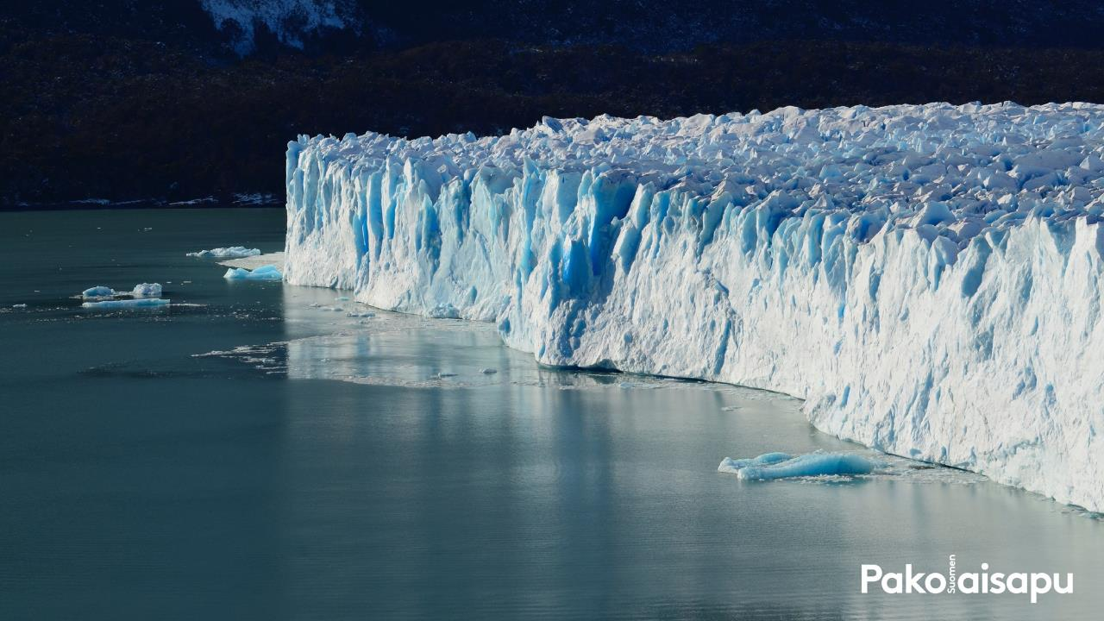
CLIMATE CHANGE AFFECTS THE REASONS FOR LEAVING IN MANY WAYS
• rising sea level
• extreme weather phenomena
• reduced food security
• acidification of seawater
• drying of inland waters
• rising temperatures
• spread of diseases

Slide 13
ASSIGNMENT: CLIMATE PICTURES
Come up with a title for the picture.
Discuss with your group: What is happening in the picture? How is the picture related to climate change? List as many things as you can come up with.

Slide 14
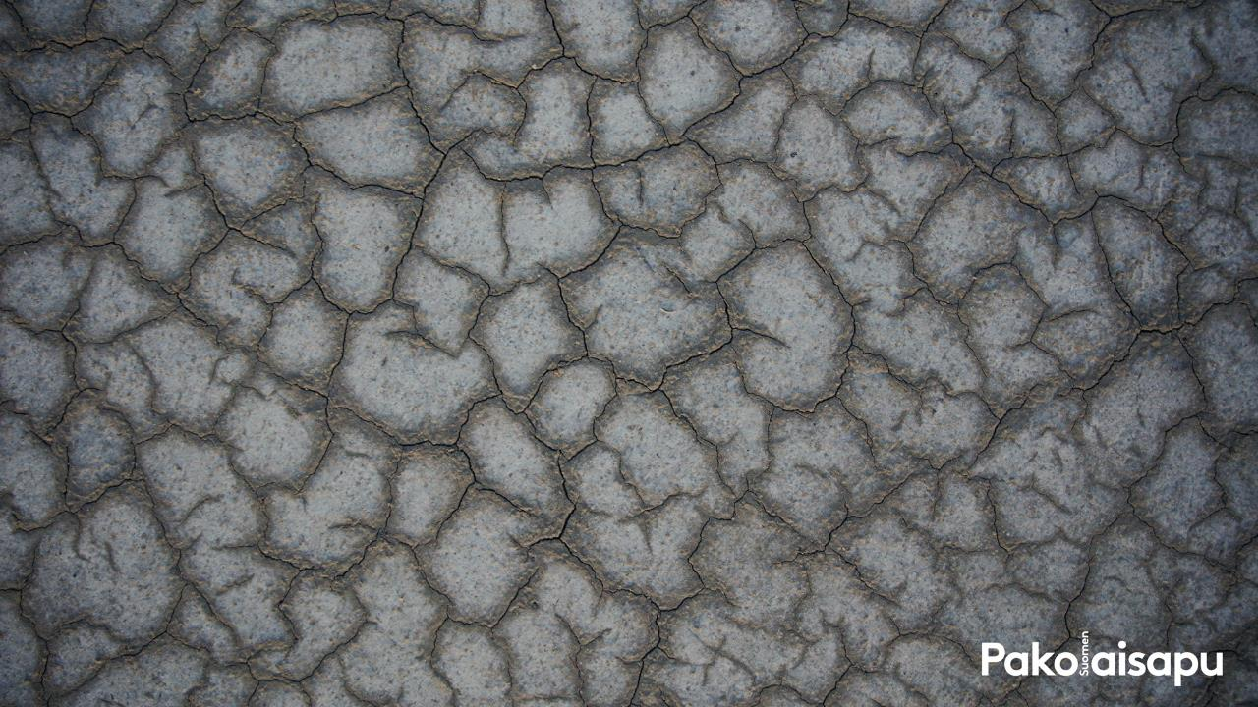
CLIMATE CHANGE HAS THE STRONGEST IMPACT IN THE MOST FRAGILE STATES
• Even though the Arctic regions are warming up faster, many of the effects are strongest near the equator.
• The countries that are the most vulnerable to climate risks are often also some of the poorest and most fragile, meaning that their ability to prepare and adjust is limited.
• Even though many of the most vulnerable countries bear the least responsibility for the emissions that accelerate climate change, they suffer the most from the effects.

Slide 15
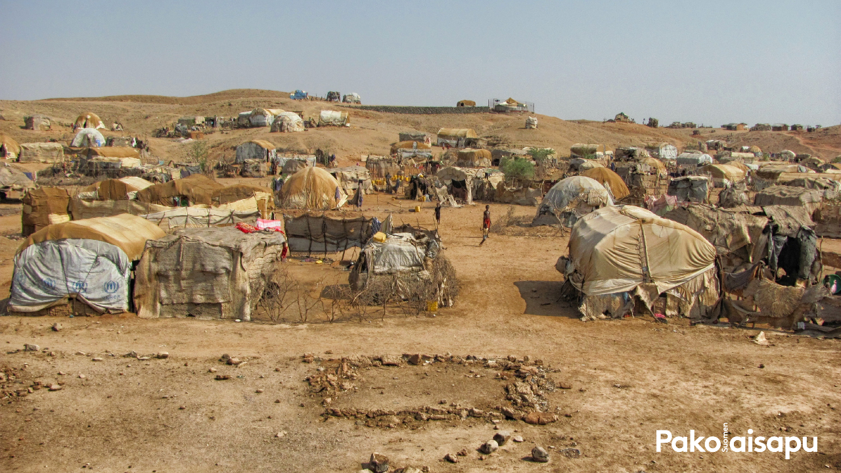
CLIMATE CHANGE AS A
CAUSE OF MIGRATION
• Climate change destroys living environments and sources of livelihood.
• At its worst, the changing climate forces people to leave their homes.
• A direct cause and effect relationship between refugees and climate change is difficult to prove.

Slide 16
CLIMATE CHANGE AS A CAUSE OF MIGRATION
Slowly occurring migration
Gradual changes
Changes in living conditions
Permanence
Sudden migration
Sudden occurrence
Sudden natural disasters
Possibility of returning

Slide 17
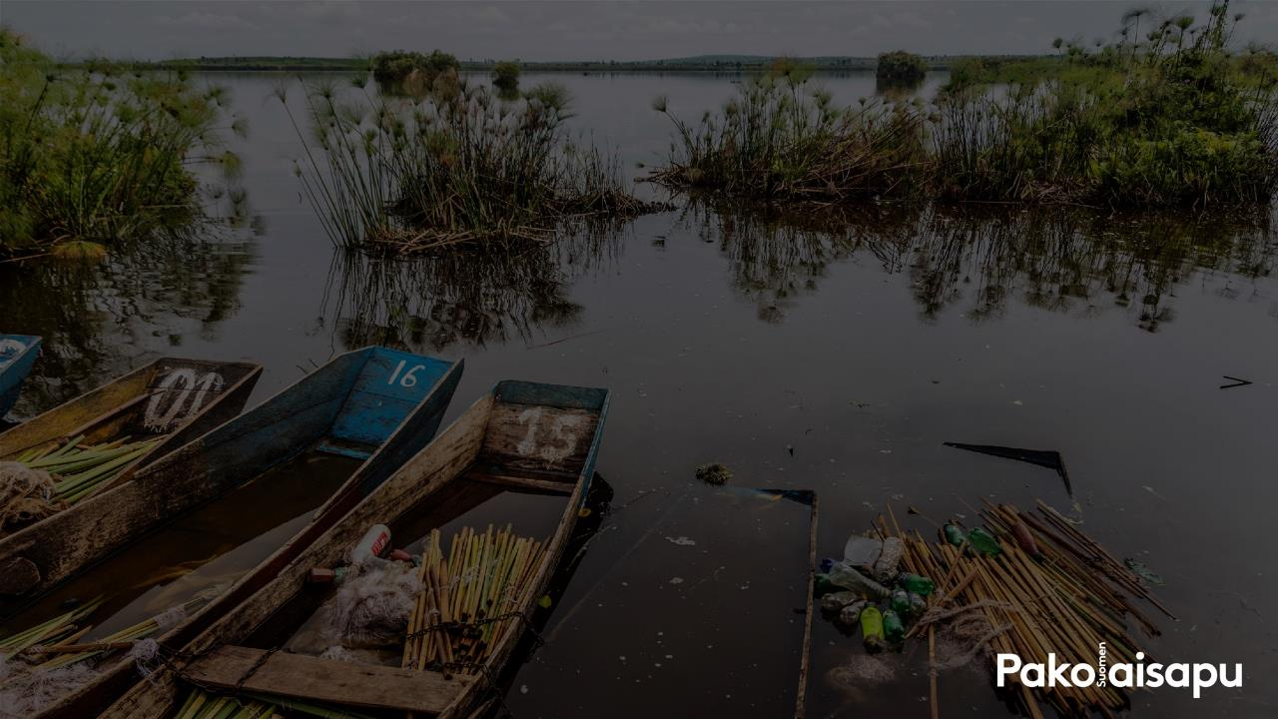
CLIMATE CHANGE
AS A RISK FACTOR
• Climate change has a direct effect on migration, but also amplifies other drivers of displacement.
• According to studies, climate change does not cause armed conflicts directly, but it may still affect their root causes.
• In areas at risk of conflict, the changing climate along with other factors have an impact on issues such as sources of livelihood or disputes over natural resources.

Slide 18
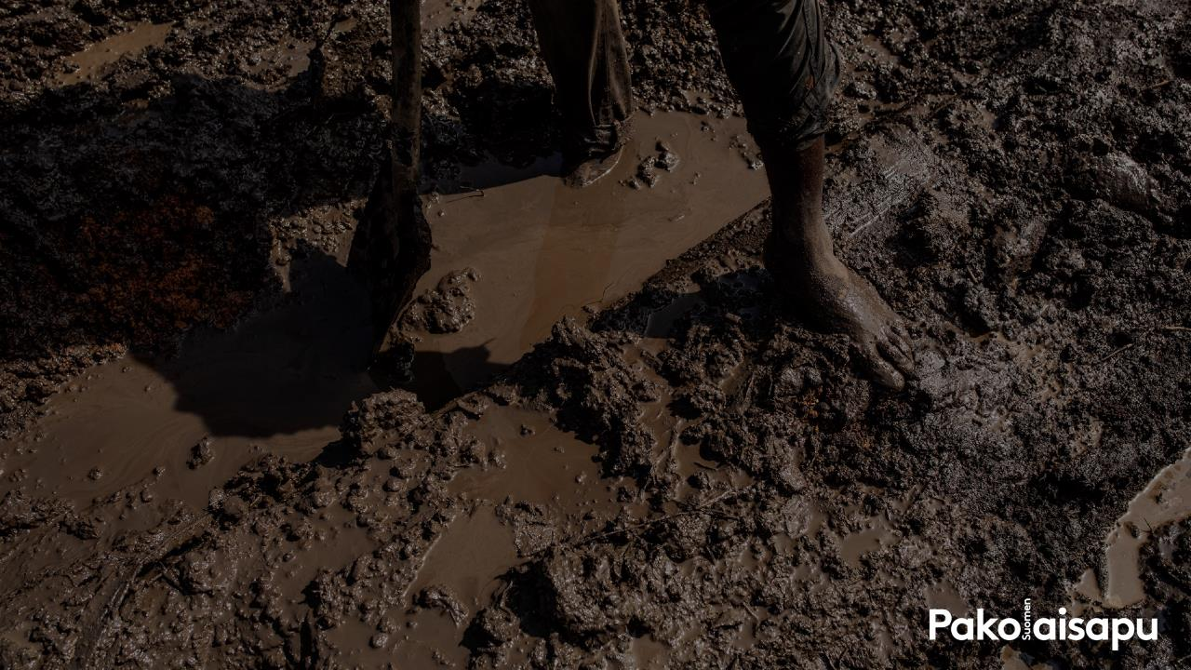
THE EFFECT ON MIGRATION
IS IMPOSSIBLE TO PREDICT
• Estimates of the number of climate migrants by 2050 vary between 25 million and one billion.
• According to the World Bank, by 2050 approximately 86 million people will be forcibly displaced within their own country due to climate change in sub-Saharan Africa, 40 million in South Asia, and approximately 17 million in Latin America.
• These areas will have ‘focal points’ of climate migration.
• In any case, it is likely that migration will increase along with climate change.

Slide 19
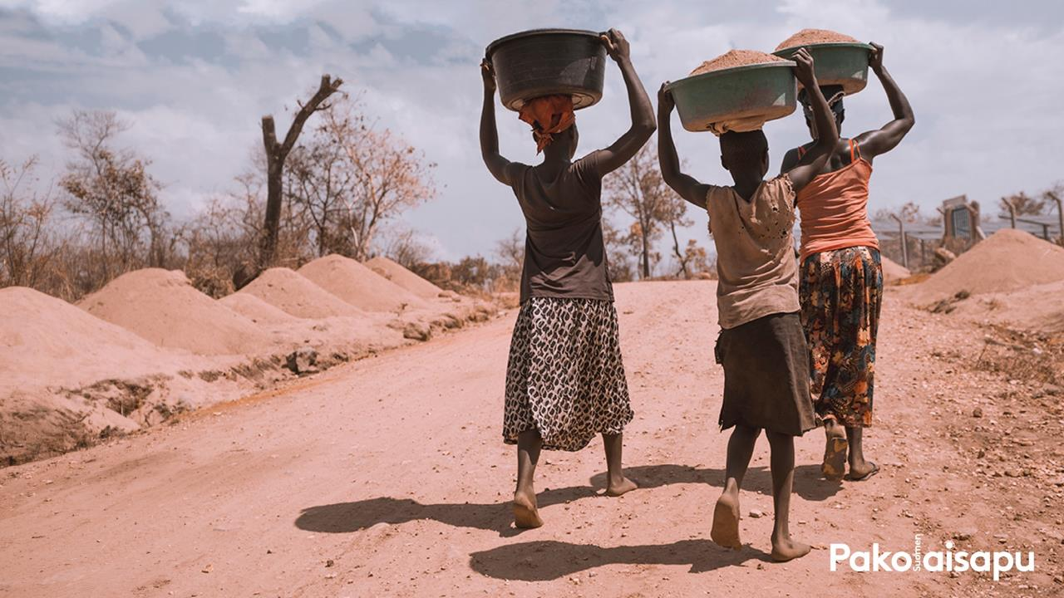
CLIMATE CHANGE PUTS
PEOPLE UNDER PRESSURE

Slide 20
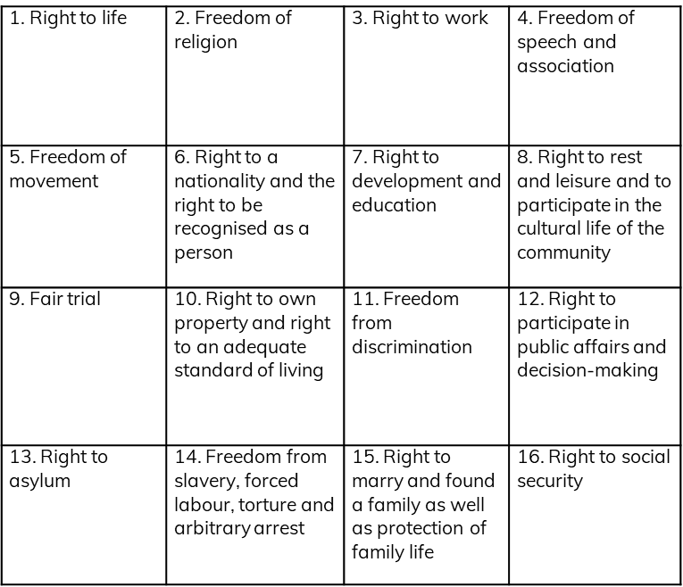
ASSIGNMENT: RIGHTS UNDER THREAT
Choose 5 human rights that you personally find the most important. Write them down on post-it notes (1 right per post-it).

Slide 21
ASSIGNMENT: RIGHTS UNDER THREAT
Listen to the text about the Nakivale refugee settlement in Uganda.
After that, take the rights (post-it-notes) that you don’t think are realised in Nakivale and turn them upside down.

Slide 22
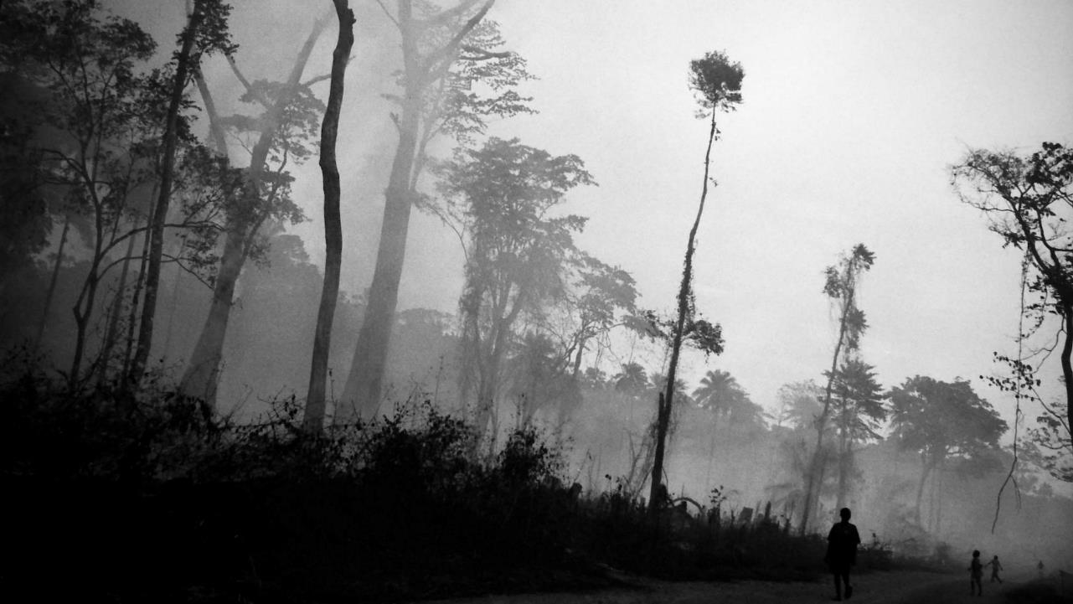
THERE ARE NO CLIMATE REFUGEES
• The international refugee legislation is based on the Geneva Refugee Convention of 1951.
• According to the Convention, a person can be granted refugee status due to persecution.
• The Convention does not specify climate change or natural disasters as grounds for asylum, which is why refugee status cannot be granted for these reasons.
• Instead of climate refugee, the term climate migrant is used.

Slide 23
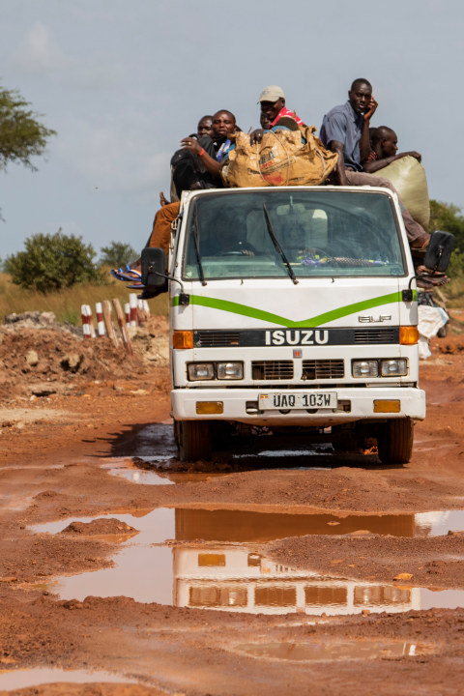
THE PEOPLE FLEEING CLIMATE CHANGE ARE IN AN EXCEPTIONAL SITUATION
• In the worst case, the people fleeing climate change are in a position, in which they have no rights.
• Even though climate migration usually focuses on nearby areas and often takes place within countries, this does not guarantee safety.
• Migrants’ situation can be insecure even when they flee within their home country.
• Migrants often have the least access to services.

Slide 24
PRESSURE ON THE RECEIVING PARTIES
• Regardless of whether the migration takes place within or across borders, it creates pressure on destinations of migration.
• Lack of resources and growing numbers of people may cause resistance to migration.
• Climate migration can nevertheless also offer opportunities for ecological and economic development.

Slide 25
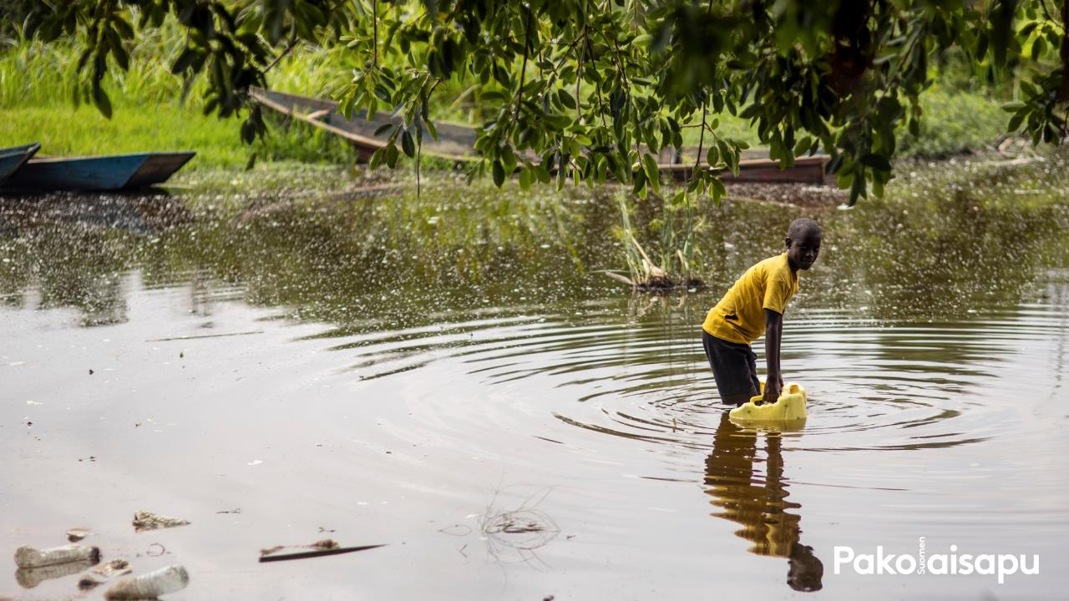
THE DISPLACED ALREADY SUFFER FROM CLIMATE CHANGE
• Refugees and displaced people are usually in the most vulnerable position with regard to the effects of climate change.
• Weather conditions have a severe impact on issues such as sources of livelihood, health and energy production.
• Climate change hinders people’s ability to cope and reduces their opportunities to rebuild their lives.
• Climate change has changed the familiar weather patterns: rainy seasons come at the wrong time.

Slide 26
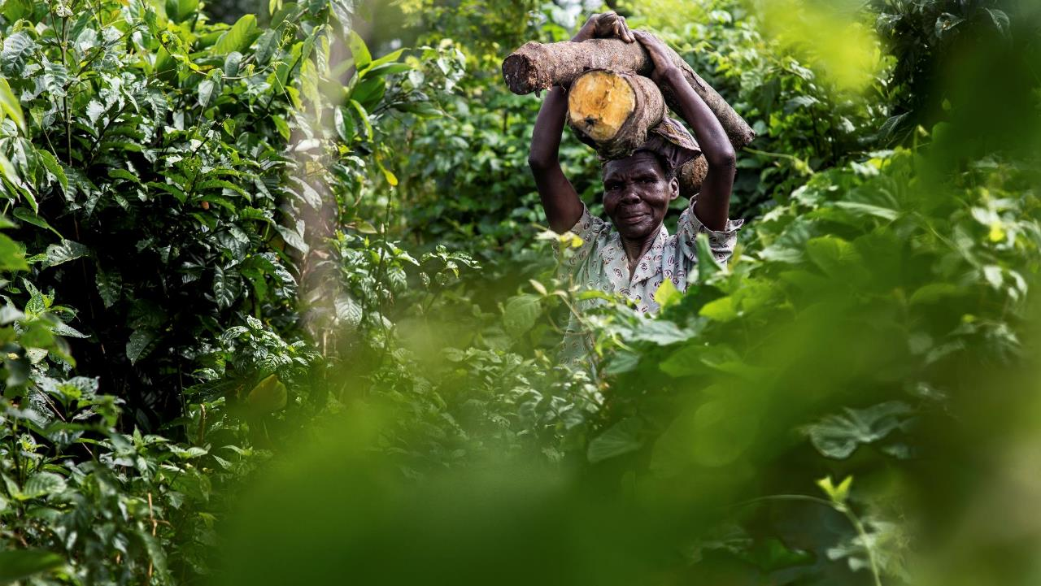
GLOBAL CHALLENGES REQUIRE GLOBAL SOLUTIONS

Slide 27

MIGRATION IS NOT A PROBLEM
• Migration has always taken place, and migration in itself is not a problem.
• Migration covers all causes for moving, such as work and studies.
• Migration can also be seen as an adaptation strategy to climate change.
• However, not all who wish to flee have the means or the opportunity to do so.
• At its worst, climate migration can be considered to contribute to inequality.

Slide 28
HOW CAN CLIMATE MIGRATION BE CONTROLLED?
• Local measures
• Adaptation and integration
• The key effects focus on those who flee climate change, not those who receive them
• Climate migration can be reduced by mitigating climate change

Slide 29
ASSIGNMENT: ADAPTATION STRATEGIES
Read the story together with your group and answer the following questions:
What kind of challenges has climate change brought into the life of the person in question?
What kind of adaptation methods have they found? How have they solved the challenges?

Slide 30
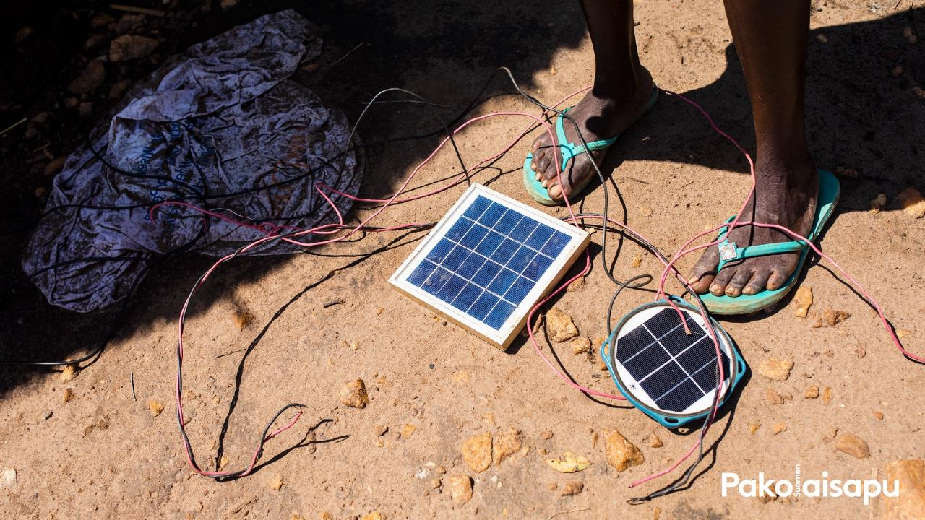
REFUGEES ARE FORCED TO ADAPT
• Those who are already displaced do not have the opportunity to influence climate change; they need to adapt to its consequences.
• Examples of refugees’ adaptation methods:
- clean energy
- coping with drought for example by digging water holes
- diversifying crops.

Slide 31

Sustainable development must be pursued
Discussion: Which goals should we pursue to meet the challenges of climate change and forced displacement? Which of the goals is especially important in Finnish Refugee Council’s work?

Slide 32
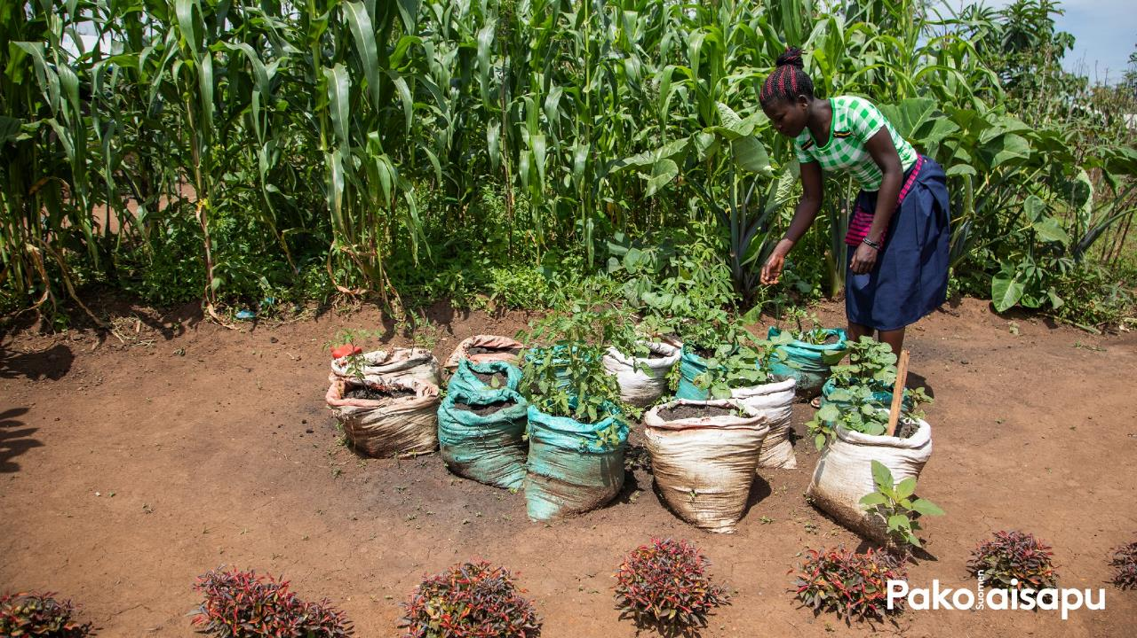
THE WORK OF NGOS MATTERS
• The Finnish Refugee Council strengthens refugees’ ability to face climate change primarily through education.
• Refugees are taught new ways to make a living as well as climate-smart agricultural practices.
- Cultivation methods such as drip irrigation and cultivation under cover help protect the environment.
- Eco-friendly stoves consume less firewood.
- Maintaining biodiversity.
• Financial and food aid are a necessity for many refugees.

Slide 33
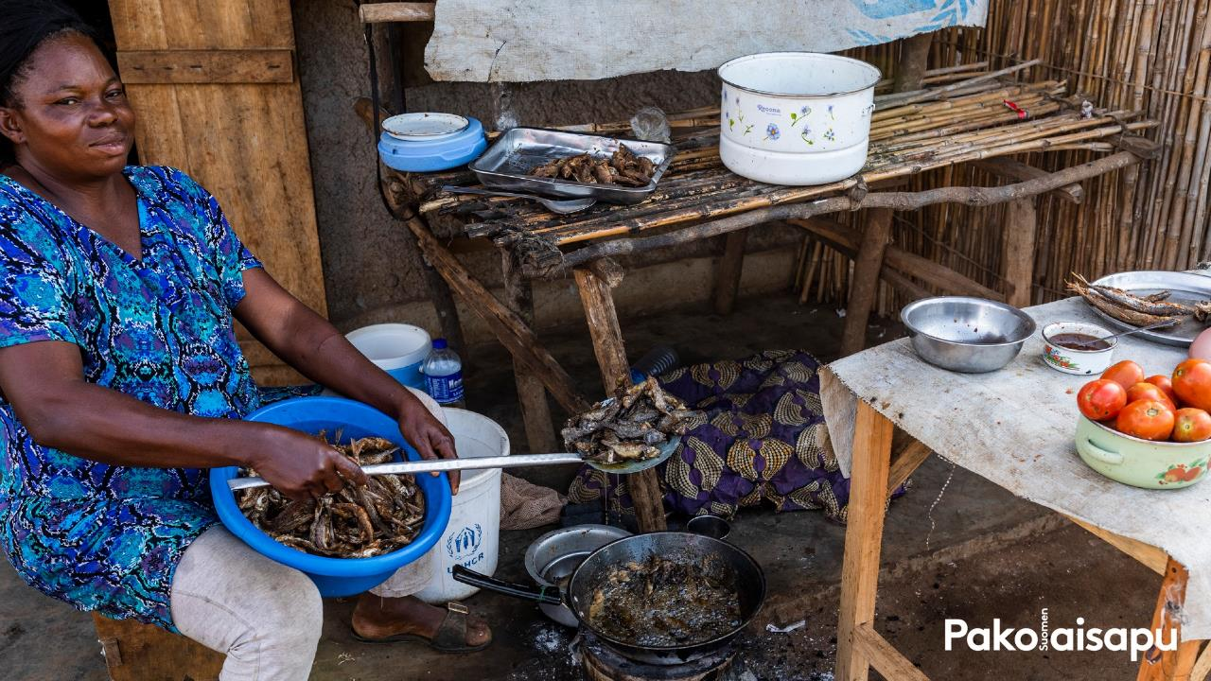
THE EFFECTS CAN BE SEEN IN GLOBAL POLITICS
• Many are under the false impression that the destination of climate migration is Europe.
• In the discussion on migration, security is often a central theme. Instead, the focus should be on development policy.
• Mitigating climate change may change the existing power and dependency relationships between countries.
• As climate change progresses. the growth of inequality may accelerate.

Slide 34
GLOBAL SOLUTIONS ARE NEEDED
• Climate change and forced migration cross state borders – the solutions must also be international.
• Solutions require political measures and decisions.
• Reopening the existing refugee legislation to also apply to those who flee climate change would cause new problems.
• Other protection mechanisms should exist for those who flee climate change.

Slide 35
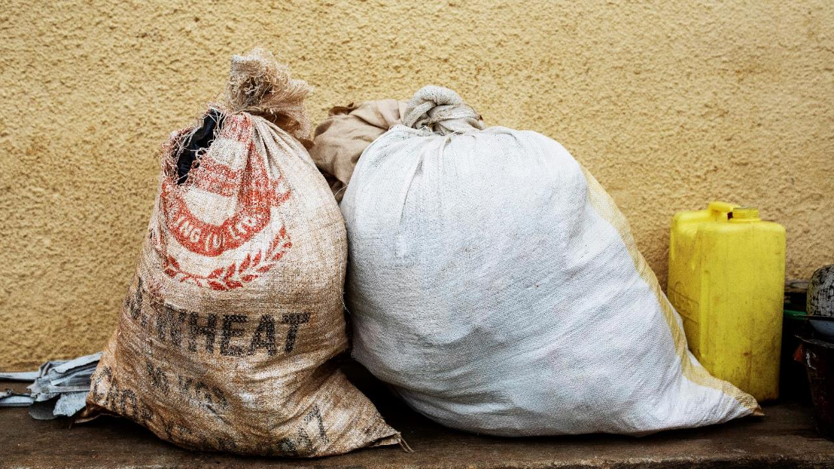
WHAT CAN I DO?

Slide 36

ASSIGNMENT: CLIMATE COMPASS
Listen to the text and imagine that it is the year 2035. Answer the following questions:
What did you do?
What did your school do?
What did Finland do?
What did the EU do?

Slide 37
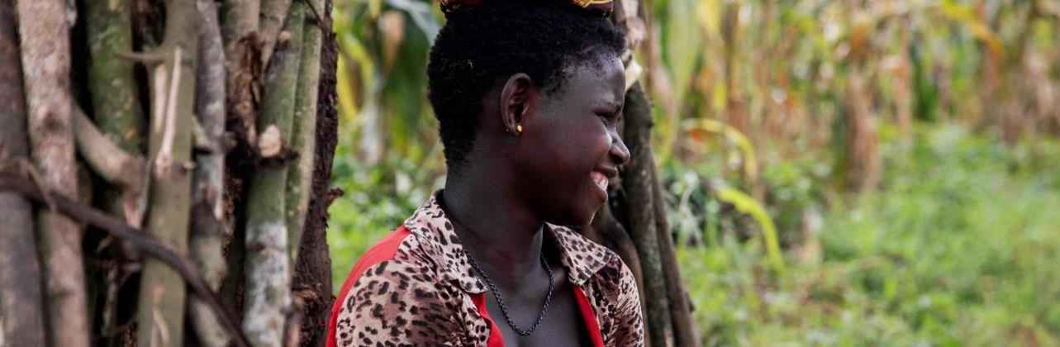



THANK YOU!
This document has been produced with the financial assistance of the European Union. The contents of this document are the sole responsibility of The Finnish Refugee Council and can under no circumstances be regarded as reflecting the position of the European Union.

